Slide 1

Friend Function and Friend Class
By: Amit Kumar Trivedi
KHYATI SCHOOL OF COMPUTER APPLICATION

Slide 2

What is friend?
Friend is Special One
What is difference between friend and non friend?
Friend has privileges to your private and protected stuffs.

Slide 3
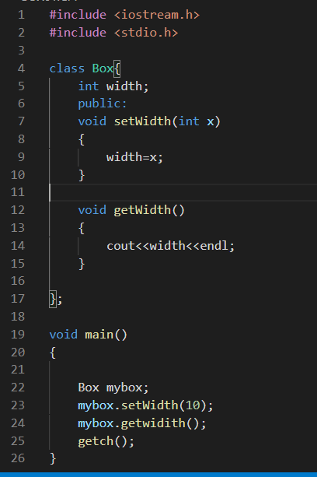
Member Functions and Data Members

Slide 4
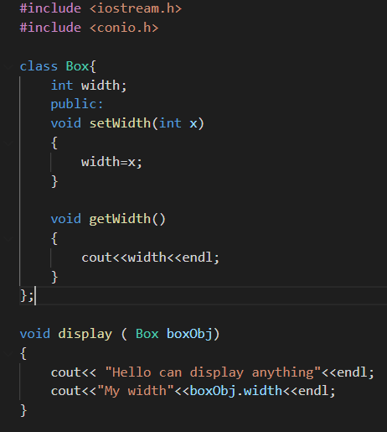
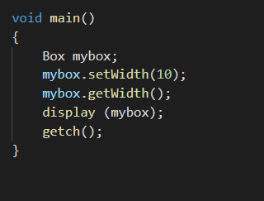
Non Member Functions which is not a friend

Slide 5
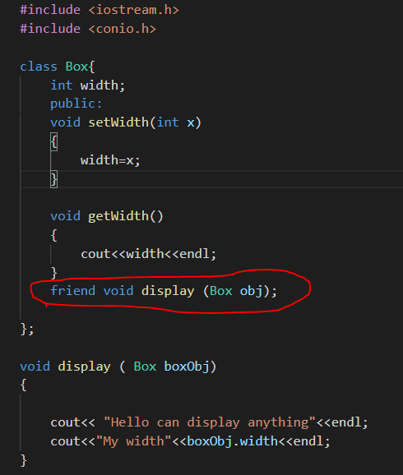
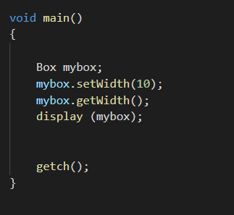
Friend Function

Slide 6
Friend
Non Member Function
Want to access private and protected member of another
Keyword: friend
Friend function prototype
Friend void display(Box)
Friend function can access private and protected member of the class.

Slide 7
Practice
Student Class has below members
Sem, Roll number and PIN
Pin is private data member
Out side class
Function : Print () non member function
Make print function friend of student class and display PIN
Create main function to demo your class code.

Slide 8
Summary
What is Class,
How to write class
How to create object of class
Accessing Data from oustide class
Difference between private and protected member
Passing object as argument to function
How to make non member function friend of class.
Practice
Student class
Friend Class
Box
Student with friend

Slide 9
Thank you

